Slide 1
DIGITAL PORTFOLIO
STUDENT NAME:S. RAAHILA ANJUM
REGISTER NO AND NMID:astvu36336324u18052
DEPARTMENT:COMPUTER SCIENCE
COLLEGE:COLLEGE/UNIVERSITY SREE ABIRAAMI ARTS AND SCIENCE COLLEGE FOR WOMEN,GUDIYATTAM FROM THIRUVALLUR UNIVERSITY

Slide 2
PROJECT TITLE
DIGITAL PORTFOLIO IN FRONT END DEVELOPMENT

Slide 3
AGENDA
1.Problem Statement
2.Project Overview
3.End Users
4.Tools and Technologies
5.Portfolio design and Layout
6.Features and Functionality
7.Result and Screenshots
8.Conclusion
9.Github Link

Slide 4
PROBLEM STATEMENT
Many students and professionals struggle to showcase their skills,projects,and achievements in a modern and organized way. traditional resumes or paper portfolios don’t effectively display creative work or evolving skills.

Slide 5
PROJECT OVERVIEW
The digital portfolio project is about creating an online platform where users can display their work,skills,and achievements in a clean and professional way.
It allows users to add information like their bio,education,projects,work experience,certificates,and contact details

Slide 6
WHO ARE THE END USERS?
1. Employers – They look at digital portfolios to decide if they want to hire you.
2. Clients – They check your work before hiring you for freelance or project-based work.
3. Teachers or Professors – They review your portfolio for grading or assessment in school.
4. College/University Admissions – They use it to evaluate your skills or creativity during applications.

Slide 7
TOOLS AND TECHNIQUES
Google Sites Easy and free websites Drag-and-drop, connects with Google Drive
Wix Creative freedom Beautiful templates, customizable design
Weebly Simple setup Good for beginners, mobile-friendly
WordPress Professional blogs or portfolios Plugins, themes, more control.

Slide 8
PORTFOLIO DESIGN AND LAYOUT
Homepage/landing page
About me
Projects/Work Samples
Contact Section

Slide 9
FEATURES AND FUNCTIONALITY
Easy Navigation
Mobile-Friendly Design
Interactive Media
Searchable or Filterable content
Skills Section

Slide 10
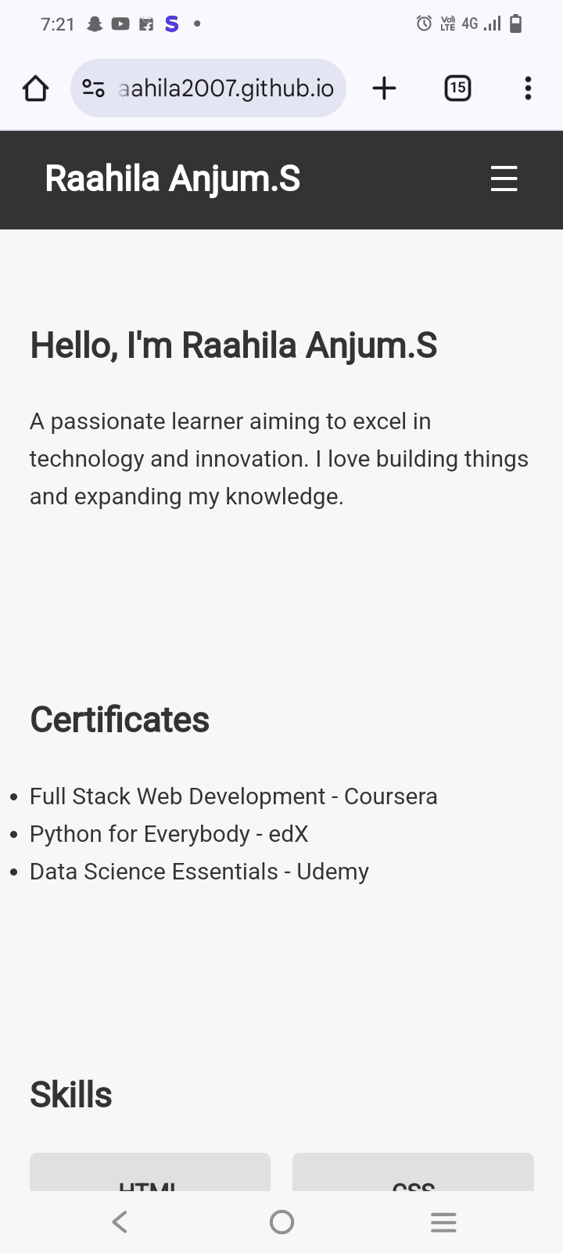
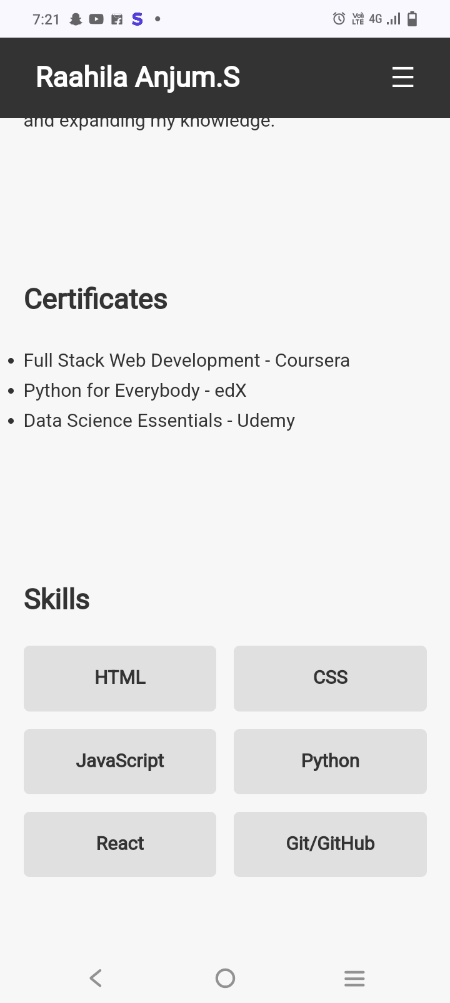
RESULTS AND SCREENSHOTS

Slide 11
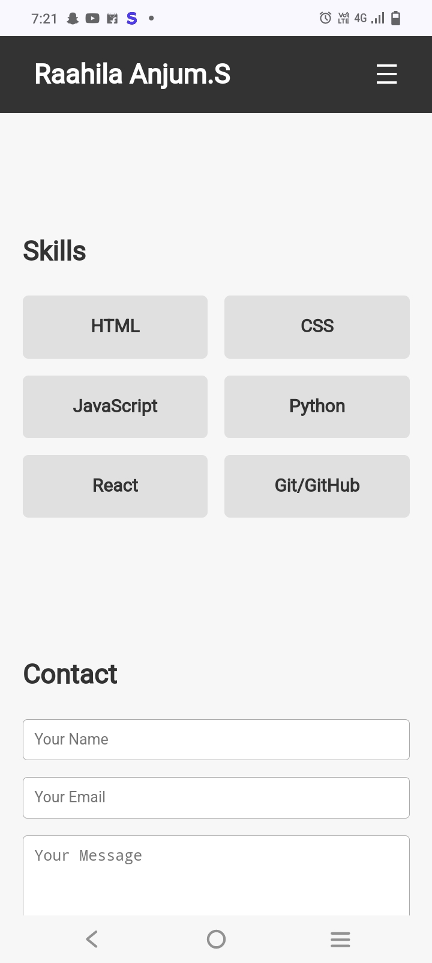
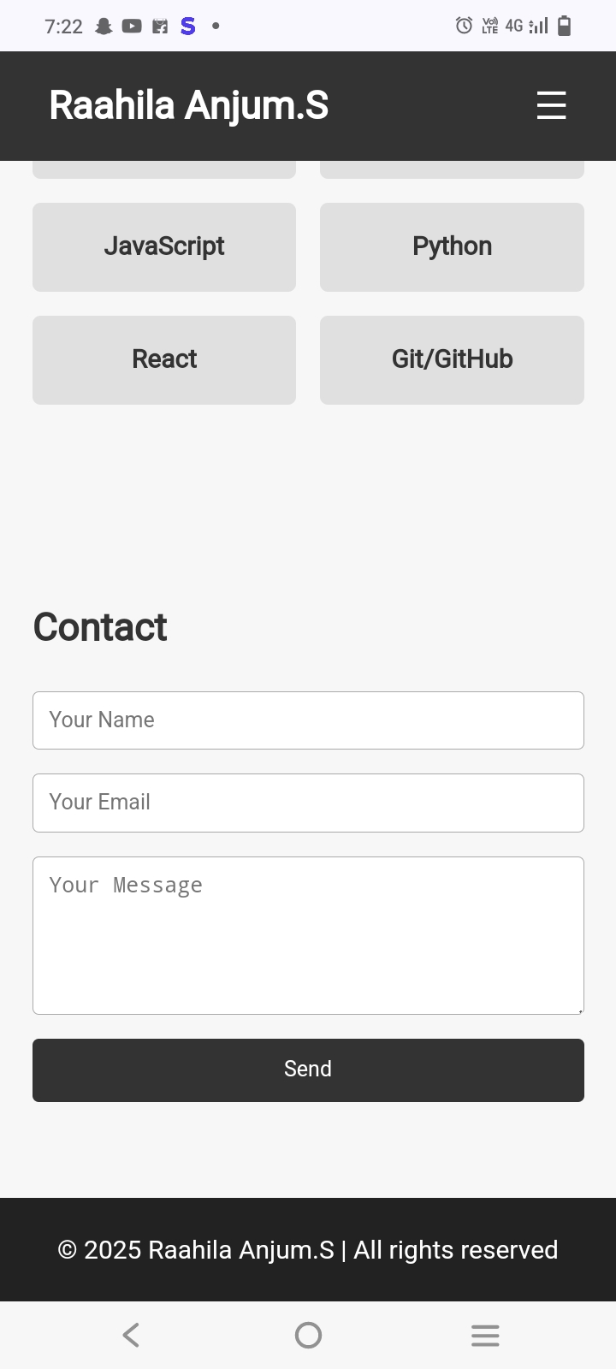

Slide 12
GITHUB AND PORTFOLIO
This is my portfolio and my digital portfolio link
https://raahila2007.github.io/raahilaanjumportfolio/

Slide 13
CONCLUSION
Thank you for taking the time to explore my portfolio . This collection of work represents my growth,creativity and dedication to learning and improve. Each project taught me something new,and I’m excited to keep building on these experiences.

